Slide 1


Trainee Selection System(TSS)
Md. Mehedi Hassan #33069 (Trainee Software Engineer)
Youth Skill Development Program (Full Stack Web Development - J2 EE)

Slide 2
Project Introduction (TSS)
A web-based platform that caters to both job applicants and administrative personnel in trainee recruitment process
A comprehensive solution designed to streamline and optimize the entire trainee recruitment process
User-friendly platform that seamlessly connects job applicants, administrators, and evaluators, facilitating a effective hiring process
28 July 2023
Trainee Selection System
2

Slide 3
Key Features (TSS)
Applicants Registration
Circular Posting
In built mailing system
Admit Card Generation
Dynamically Round Creation
Candidate filtering
Notice Posting
Track Participants using UId
Participants Marks upload for admin & evaluator
28 July 2023
Trainee Selection System
3

Slide 4





Tools & Technology
Programming Languages
- Java, JavaScript
Frameworks
- Spring
Libraries
- React Js, Ant Design,
Zxing, Jsoup, Lombok
Database
- MySQL
Operating System
- Windows
Code Editor & IDE
- IntelliJ, VS Code
Project Management tools
- Redmine
Build automation tool
- Gradle, npm, Vite
28 July 2023
Trainee Selection System
4

Slide 5
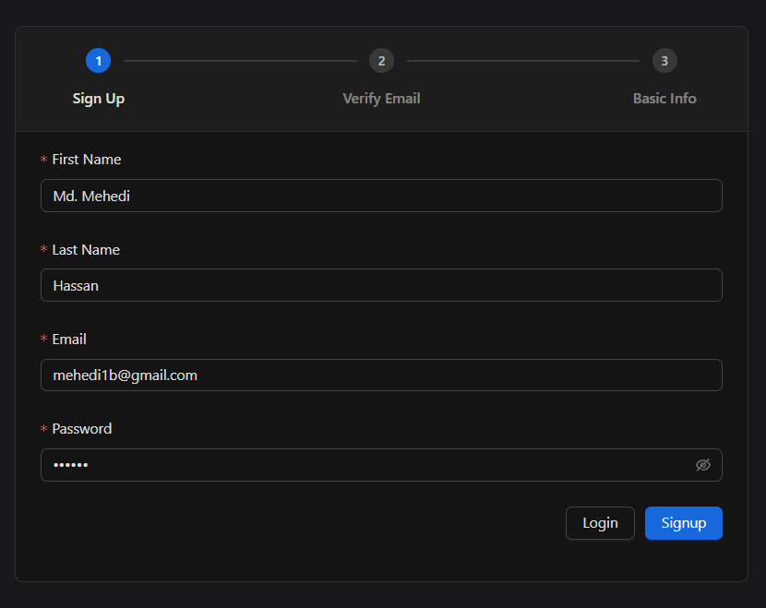
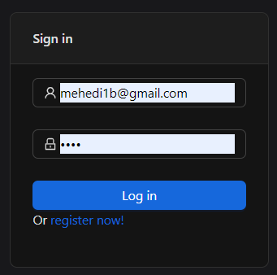
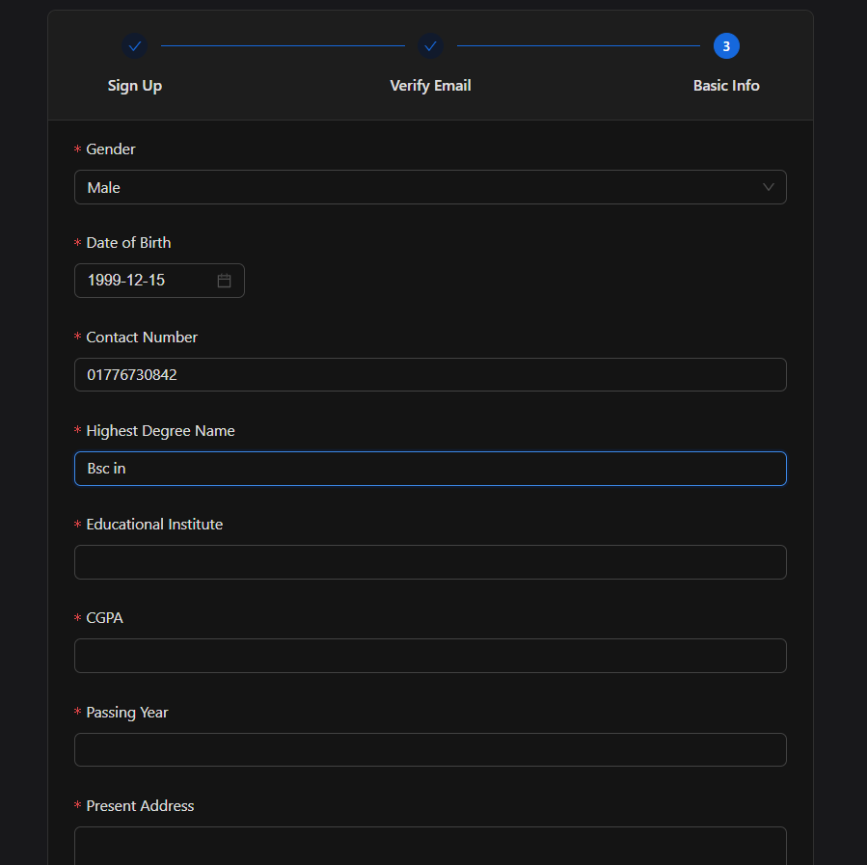
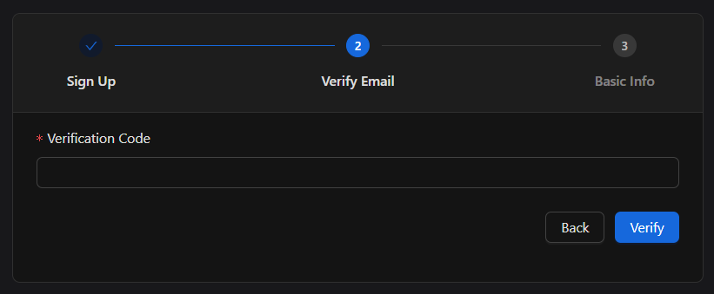
Screenshots of the UI (User Sign in & Sign up)
Fig: Activities in sing in & sign up
28 July 2023
Trainee Selection System
5

Slide 6
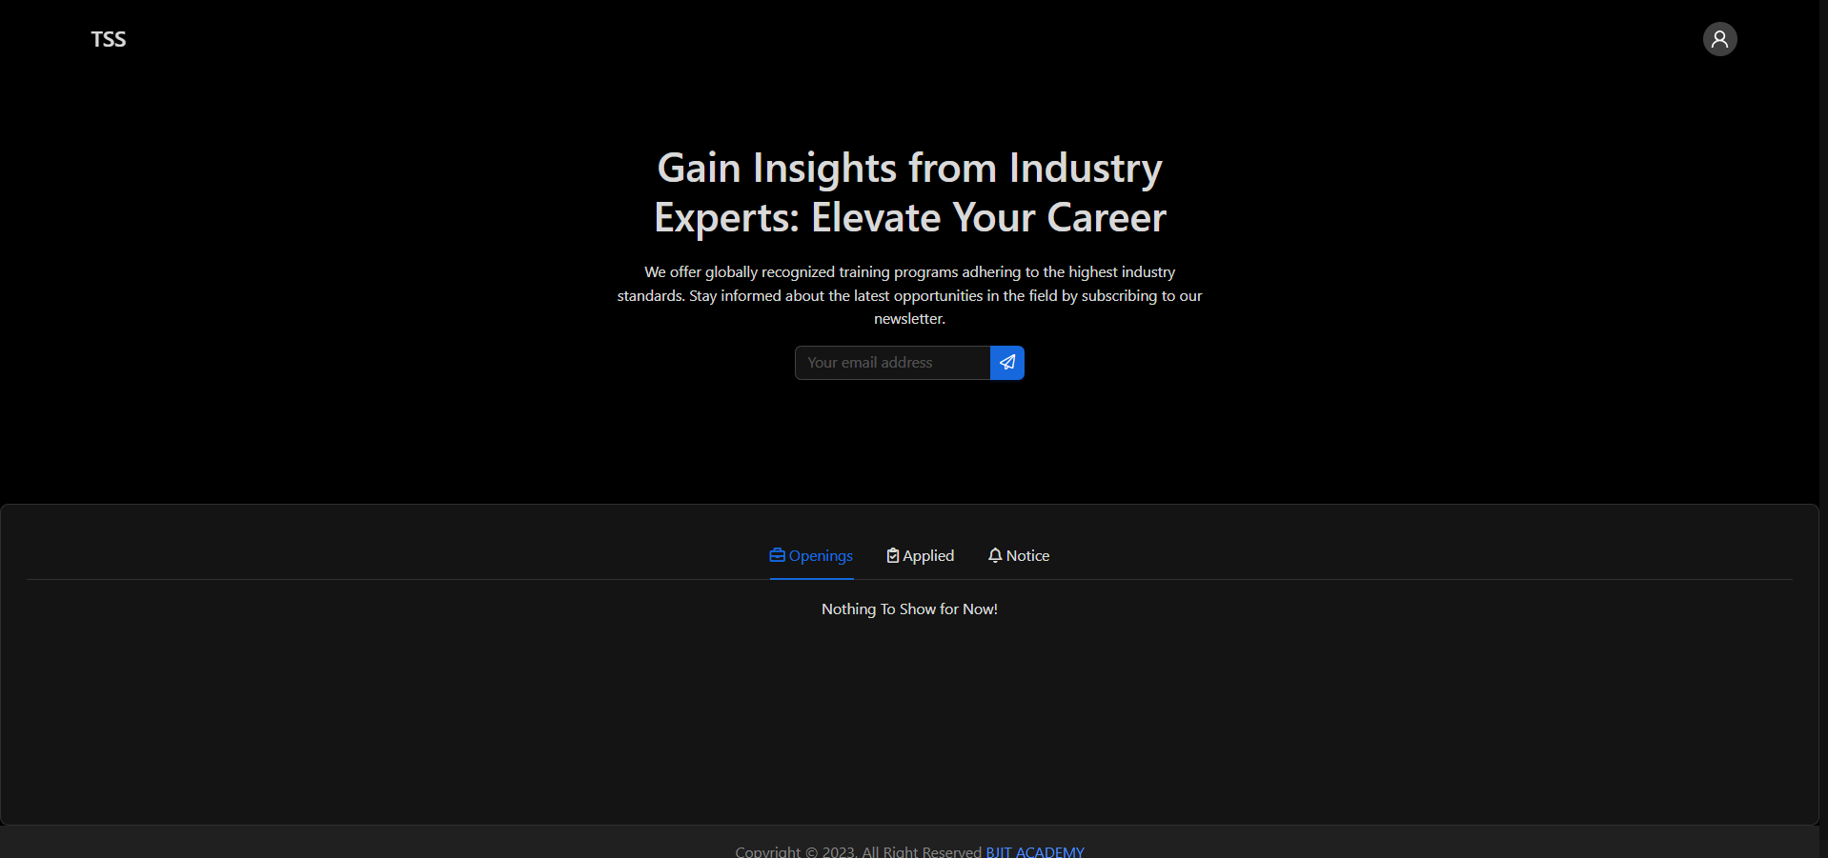
Screenshots of the UI (Applicant’s Feature)
Fig: Landing Page of the web app (TSS)
28 July 2023
Trainee Selection System
6

Slide 7
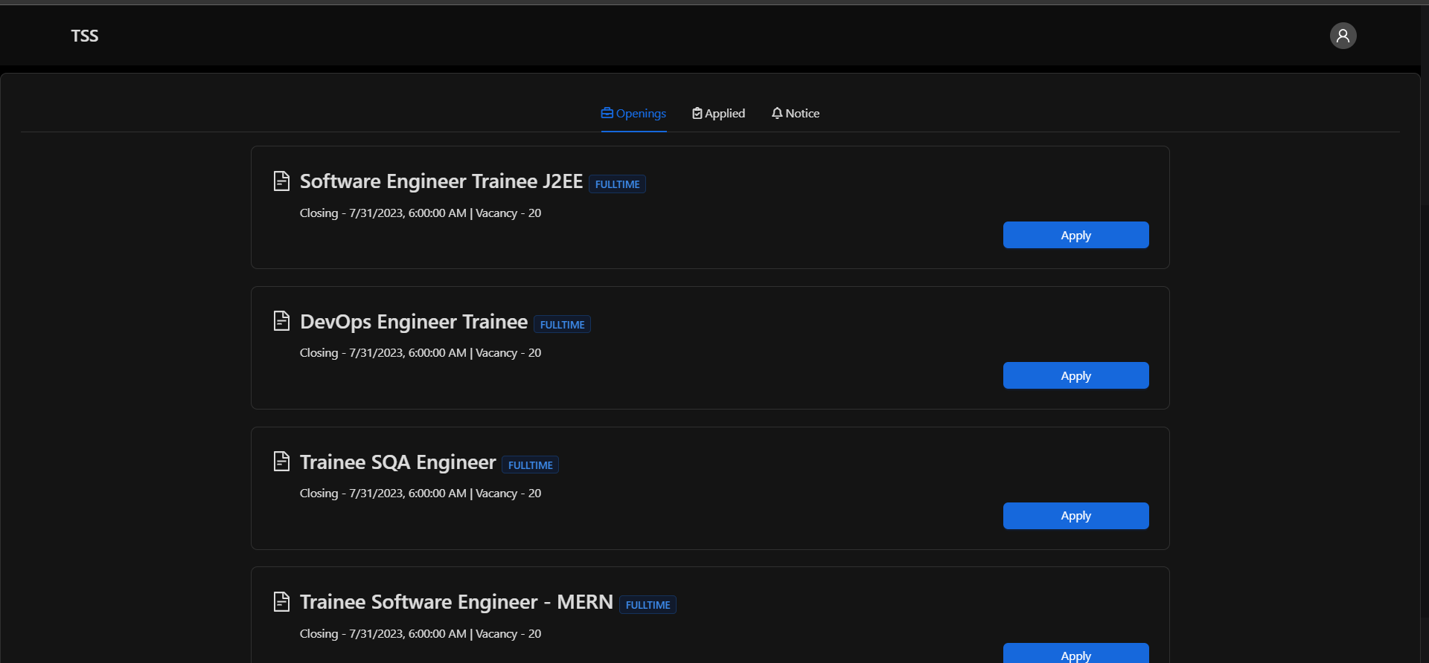
Screenshots of the UI (Applicant’s Feature)
Fig: Openings Tab (TSS)
28 July 2023
Trainee Selection System
7

Slide 8
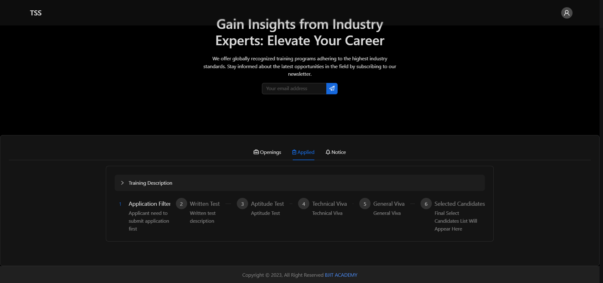
Screenshots of the UI (Applicant’s Feature)
Fig: Openings Tab (TSS)
28 July 2023
Trainee Selection System
8

Slide 9
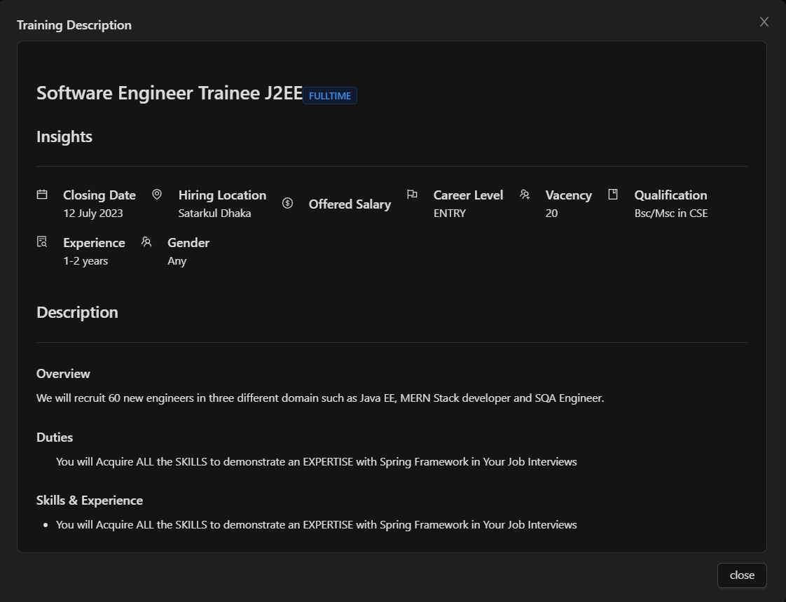
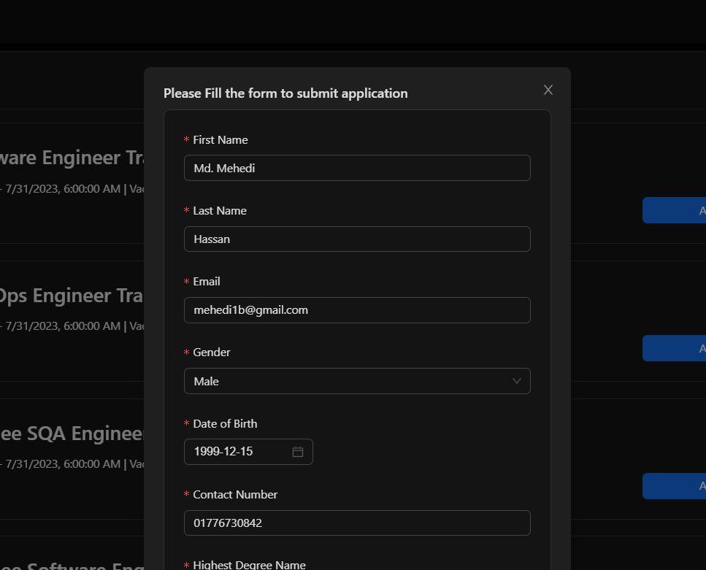
Screenshots of the UI (Applicant’s Feature)
Fig: Training Description and Application form
28 July 2023
Trainee Selection System
9

Slide 10

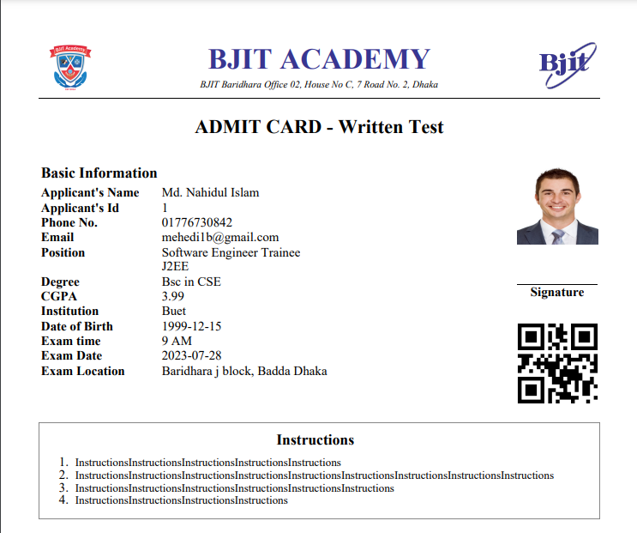
Screenshots of the UI (Applicant’s Feature)
Fig: Generated Admit Card (TSS)
28 July 2023
Trainee Selection System
10

Slide 11
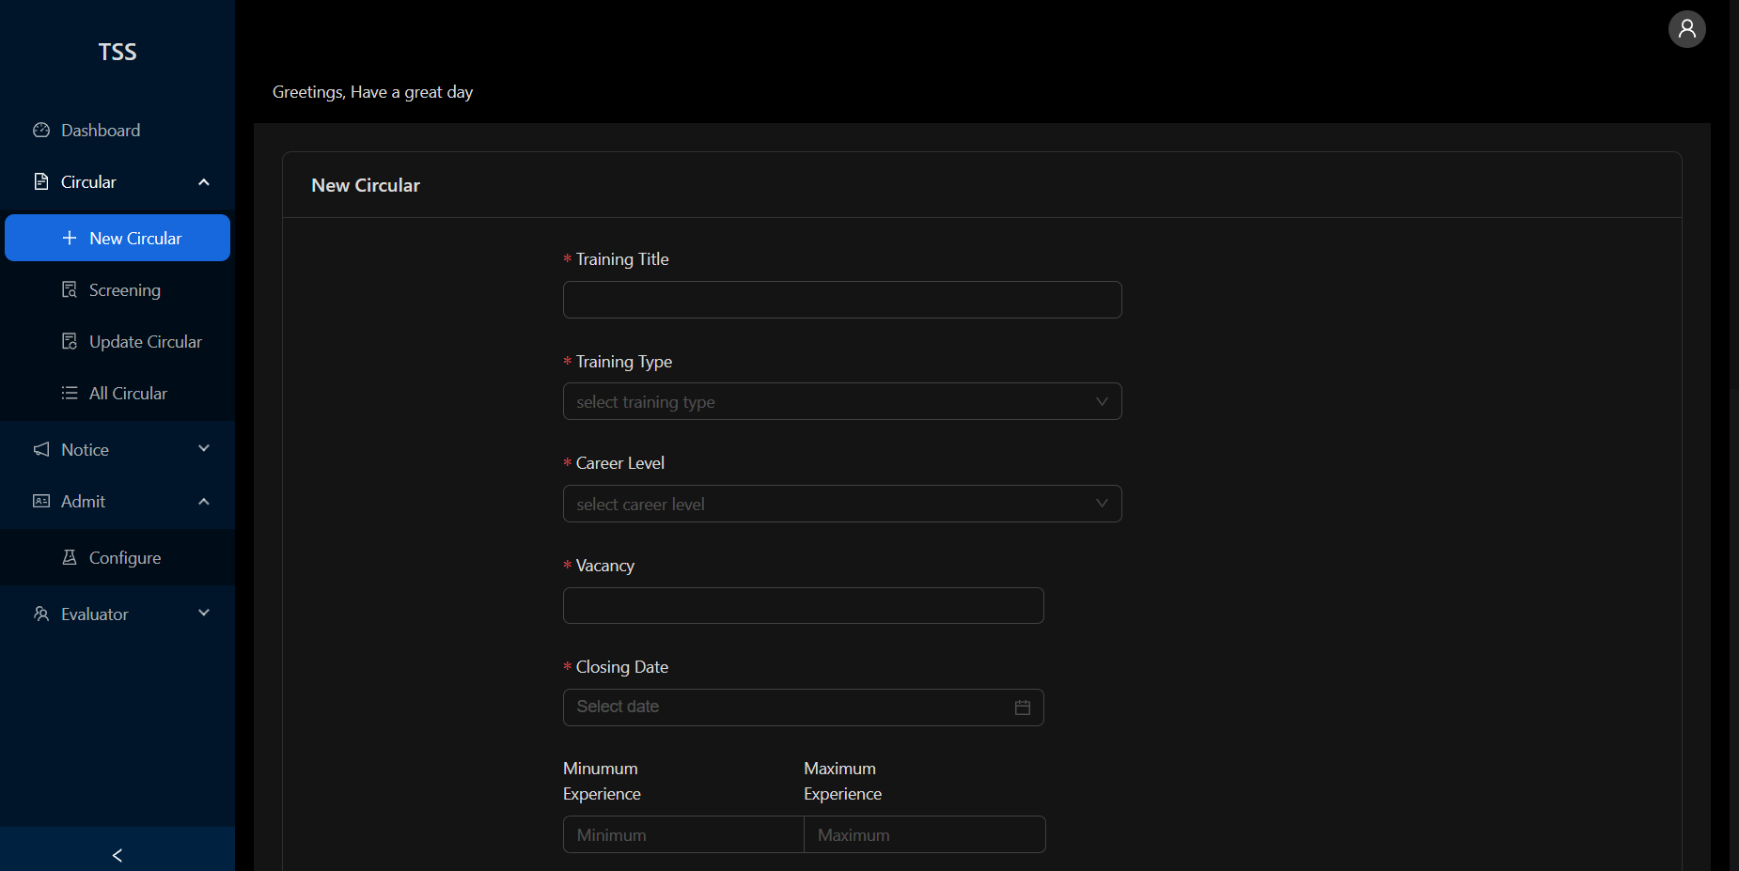
Screenshots of the UI (Admin)
Fig: New Circular form
28 July 2023
Trainee Selection System
11

Slide 12
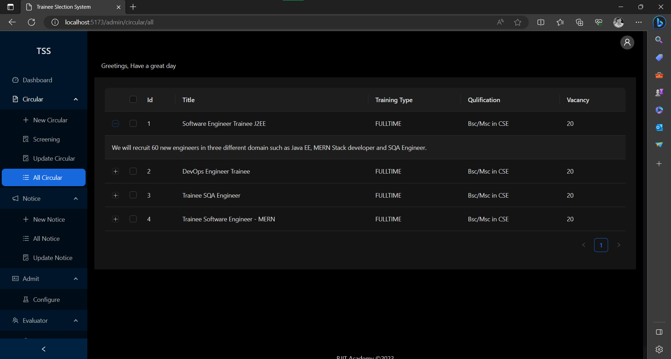
Screenshots of the UI (Admin)
Fig: Activities in sing in & sign up
28 July 2023
Trainee Selection System
12

Slide 13
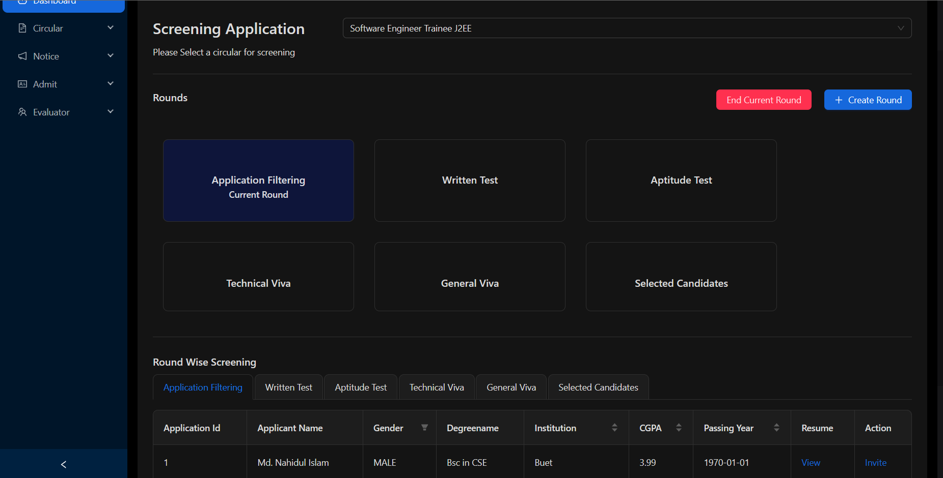
Screenshots of the UI (Admin)
Fig: Activities in sing in & sign up
28 July 2023
Trainee Selection System
13

Slide 14
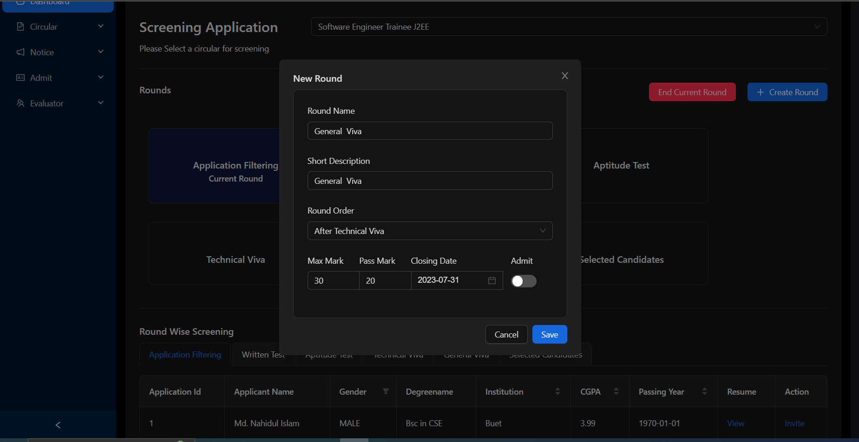
Screenshots of the UI (Admin)
Fig: Activities in sing in & sign up
28 July 2023
Trainee Selection System
14

Slide 15
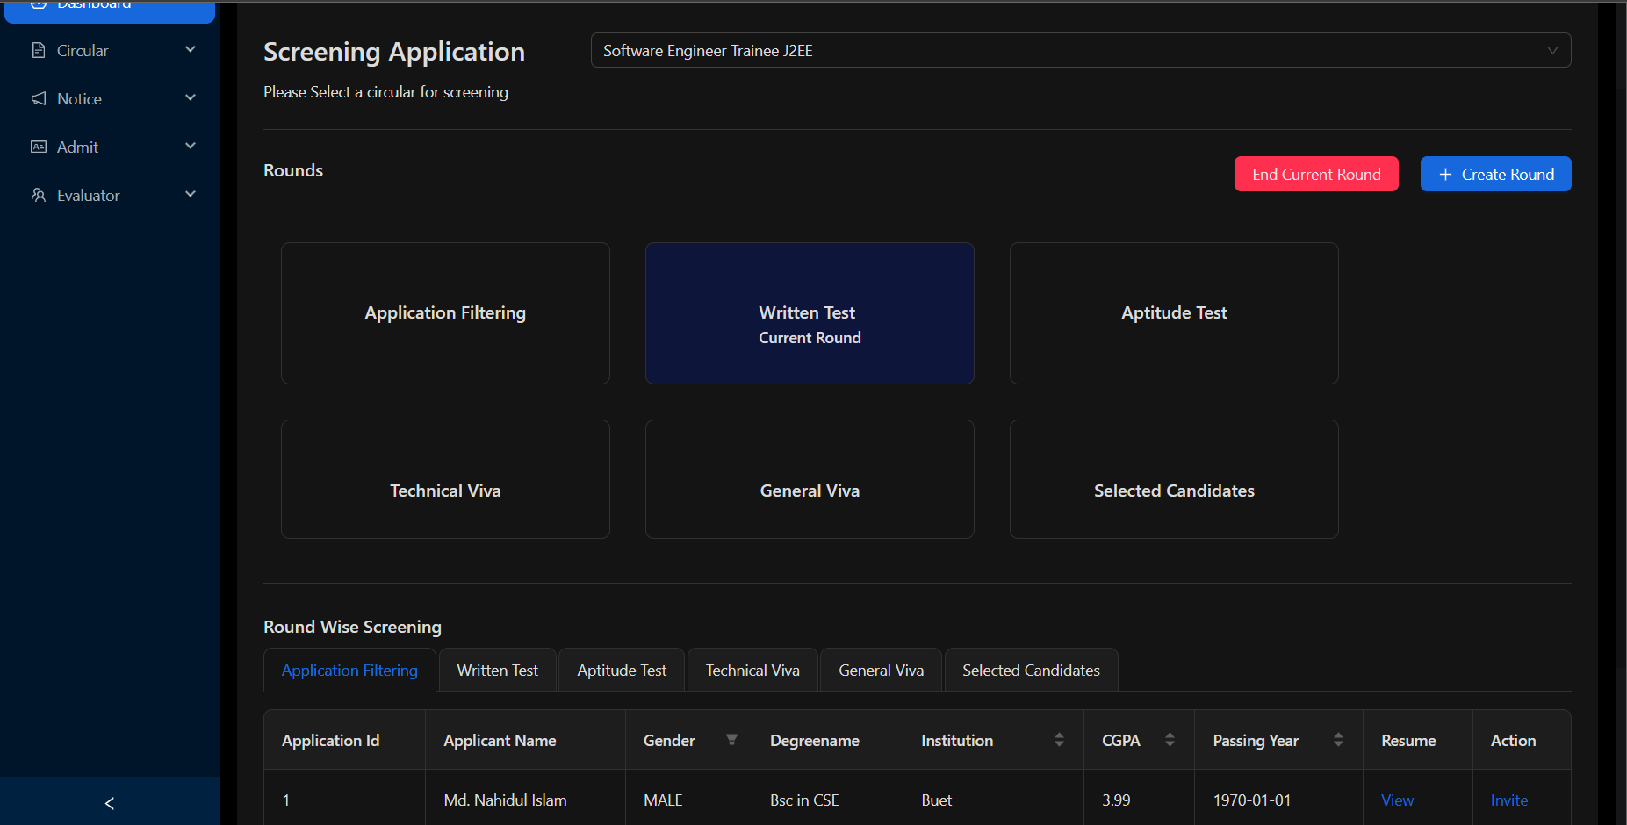
Screenshots of the UI (Admin)
Fig: Application Screening Section
28 July 2023
Trainee Selection System
15

Slide 16
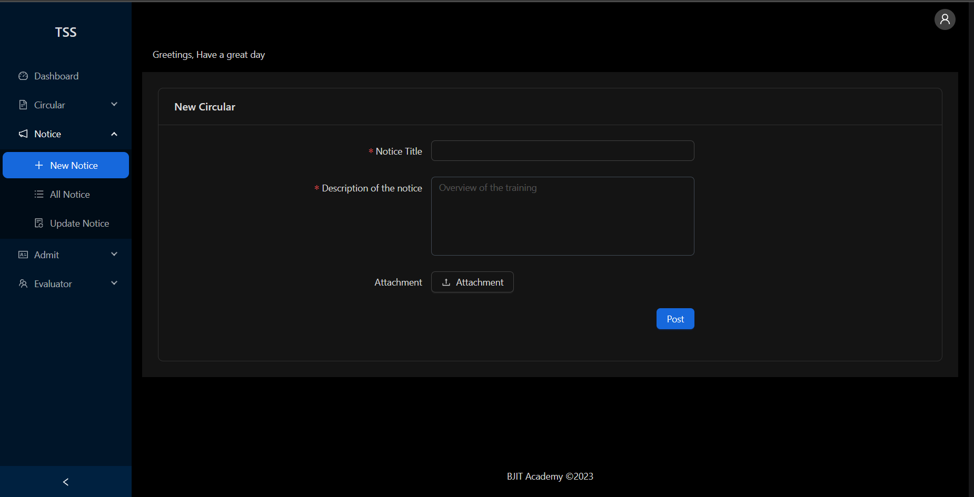
Screenshots of the UI (Admin)
Fig: Notice posting form
28 July 2023
Trainee Selection System
16

Slide 17
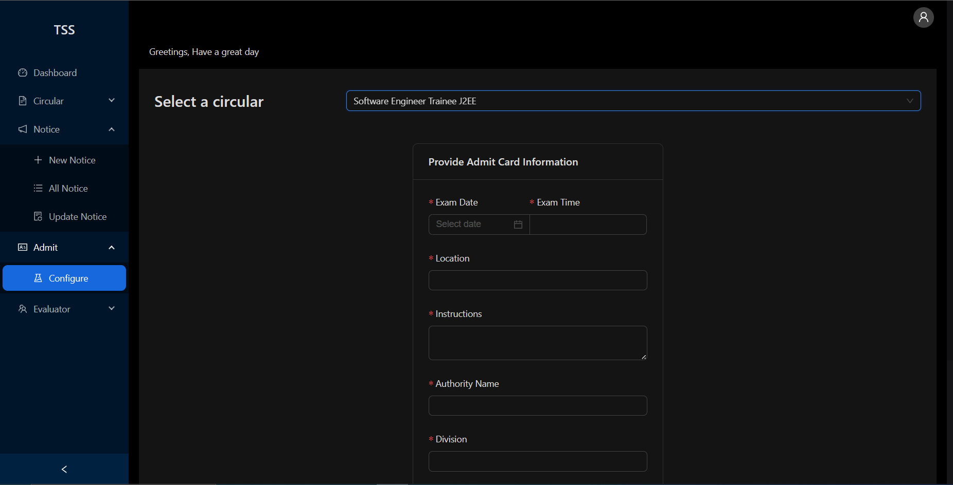
Screenshots of the UI (Admin)
Fig: Admit Card information form
28 July 2023
Trainee Selection System
17

Slide 18
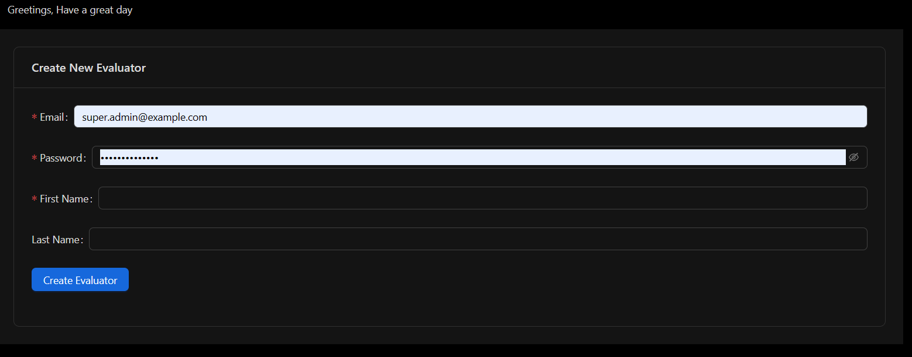
Screenshots of the UI (Admin)
Fig: Evaluator Creation Form
28 July 2023
Trainee Selection System
18

Slide 19
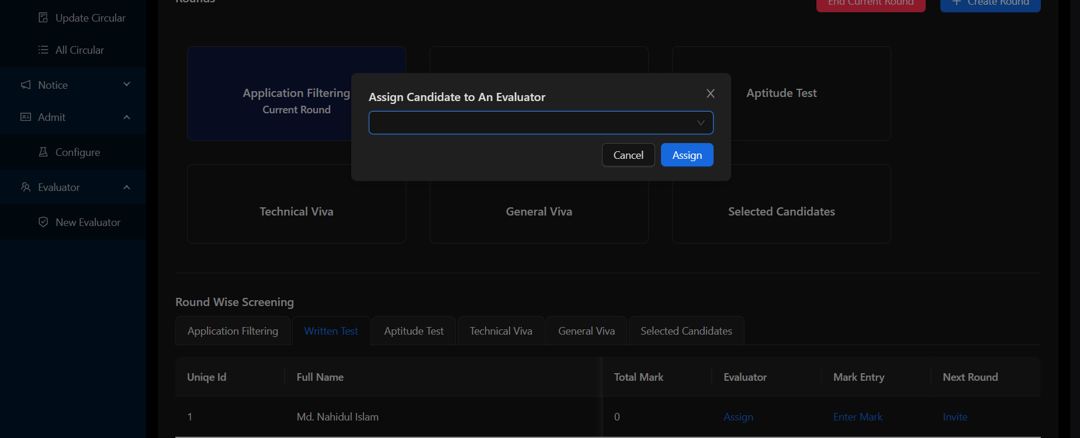
Screenshots of the UI (Admin)
Fig: Assigning Evaluator
28 July 2023
Trainee Selection System
19

Slide 20
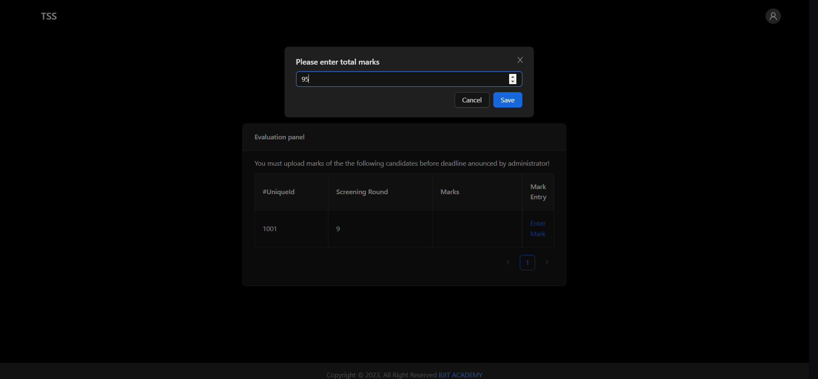
Screenshots of the UI (Evaluator)
Fig: Evaluation Panel
28 July 2023
Trainee Selection System
20

Slide 21
Learnings from this Project
Get Experience of working in Large project
Learned how to explore completely new tools & technologies to me and utilize them in real world project
Helps a lot in sharpening the previously gained knowledge from this training
Learned how to work under pressure
28 July 2023
Trainee Selection System
21

Slide 22
Enhancement Proposal
User management feature for admin
Profile base feature for all type of user
Including marking criteria in every round
Improvement in alert & notification
Improvement in performance for CPU intensive task
28 July 2023
Trainee Selection System
22

Slide 23
Question & Answer Session
?

Slide 24


